Slide 1
HOW TO MAKE A WEBSITE
PRESENTED BY JAY MO & SU MIN

Slide 2
HI, I’M JAY MO
INTRODUCTION
HOW TO MAKE A WEBSITE
And I’m a web developer

Slide 3
SHE’S SU MIN
INTRODUCTION
HOW TO MAKE A WEBSITE
And she’s also a web developer

Slide 4
WHAT YOU’LL NEED
INTRODUCTION
HOW TO MAKE A WEBSITE
Some text editor (Brackets, Sublime Text, Atom)
Internet connection
Positive attitude (optional, but highly preferred)

Slide 5
AGENDA

Slide 6
HTML5
CSS3
Bootstrap
JavaScript
Deploy

Slide 7
HTML5
STRUCTURE OF YOUR WEBSITE

Slide 8
HTML5: OVERVIEW
BASICS AND BACKGROUND ON HTML5

Slide 9
WHAT IS HTML5?
HTML5: OVERVIEW
HOW TO MAKE A WEBSITE

Slide 10
WHAT IS HTML5?
HTML5: OVERVIEW
HOW TO MAKE A WEBSITE
Stands for HYPER TEXT MARKUP LANGUAGE
Very commonly used to build websites
Consisted of tags

Slide 11
WHAT ARE TAGS?
HTML5: OVERVIEW
HOW TO MAKE A WEBSITE
Keywords that define how it’s formatted and displayed
Looks like <tag>
Must close with </tag> if multi-line

Slide 12
GO TO JAYMO.ME/CDNJ
HTML5: OVERVIEW
HOW TO MAKE A WEBSITE
CLONE OR DOWNLOAD THE FILES

Slide 13
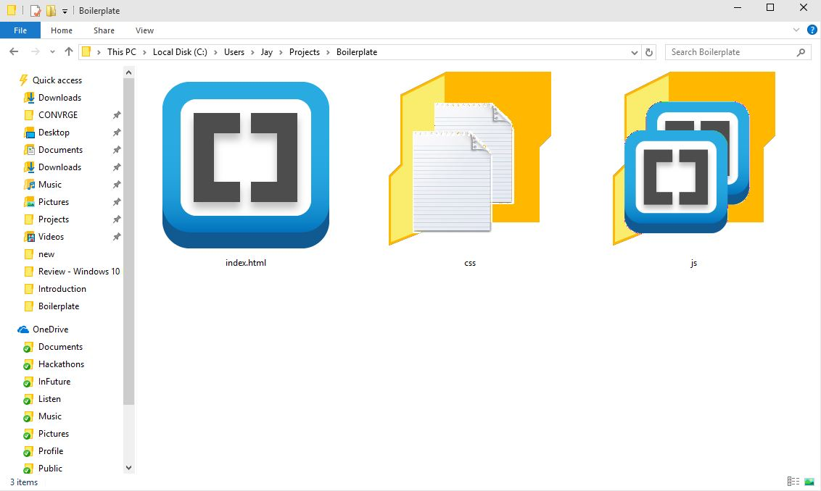
HERE ARE THE FILES
HTML5: OVERVIEW
HOW TO MAKE A WEBSITE

Slide 14
FILE STRUCTURE
HTML5: OVERVIEW
HOW TO MAKE A WEBSITE
<!DOCTYPE html> Declaration tag
<html> Encloses the document
<head> Represents the header
<title> Title of document
<body> Represents the content

Slide 15
HTML5: USEFUL TAGS
THE POPULAR ONES YOU’LL NEED

Slide 16
HEADING
HTML5: USEFUL TAGS
HOW TO MAKE A WEBSITE
<h1>This is for big titles</h1>
<h2>This is for section titles</h2>
<h3>This is small</h3>
<h4>This is really small</h4>
<h5>This is really really small</h5>
<h6>This is really really really small</h6>

Slide 17
PARAGRAPH
HTML5: USEFUL TAGS
HOW TO MAKE A WEBSITE
<p>This is used for long text</p>
<i>italics</i>
<b>bold</b>
<br>

Slide 18
LIST
HTML5: USEFUL TAGS
HOW TO MAKE A WEBSITE
<ul> Specifies an unordered list
<li> List item
<ul>
<li>Item 1</li>
<li>Item 2</li>
</ul>

Slide 19
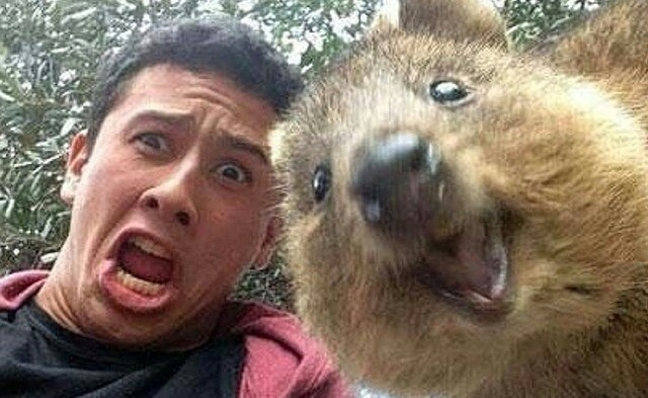
IMAGES
HTML5: USEFUL TAGS
HOW TO MAKE A WEBSITE
<img src=“quokka.jpg”>

Slide 20
LAYOUT
HTML5: USEFUL TAGS
HOW TO MAKE A WEBSITE
<div> Div
<section> Section
<header> Header
<article> Article
<footer> Footer

Slide 21
FORMS & BUTTONS
HTML5: USEFUL TAGS
HOW TO MAKE A WEBSITE
<input> Input
<button> Button
<form> Form

Slide 22
MISCELLANEOUS
HTML5: USEFUL TAGS
HOW TO MAKE A WEBSITE
<a> Links
<link> Import styling
<script> Import script (JS)

Slide 23
HTML5: ATTRIBUTES
ATTRIBUTES ARE BASICALLY TRAITS OR PROPERTIES

Slide 24
WHAT ARE ATTRIBUTES?
HTML5: ATTRIBUTES
HOW TO MAKE A WEBSITE
Attributes provide additional information
i.e. <p id=“attribute”>#hellyeah</p>

Slide 25
COMMON ATTRIBUTES
HTML5: ATTRIBUTES
HOW TO MAKE A WEBSITE
ID Specify an identifier
CLASS Specify a group
STYLE Style the element
ONEVENT Triggers on event

Slide 26
SPECIAL ATTRIBUTES
HTML5: ATTRIBUTES
HOW TO MAKE A WEBSITE
<a href=“link”> Link to something
<img src=“file”> Pulls data from file

Slide 27
CSS3
MAKE YOUR WEBSITE BEAUTIFUL

Slide 28
WHAT IS CSS3?
HTML5: OVERVIEW
HOW TO MAKE A WEBSITE

Slide 29
WHAT IS CSS3?
HTML5: OVERVIEW
HOW TO MAKE A WEBSITE
It’s like makeup for your HTML
Very commonly used to build websites
Consisted of properties and attributes

Slide 30
CSS3: SYNTAX
FILLER TEXT RIGHT HERE THIS FONT IS BEAUT

Slide 31
SYNTAX
CSS3: SYNTAX
HOW TO MAKE A WEBSITE
Target: element, class, id
Consisted of properties and attributes
target {
property: attribute;
}

Slide 32
SELECTORS
CSS3: SELECTORS
HOW TO MAKE A WEBSITE
p { /* HTML elements */ }
.class { /* Class elements */ }
#id { /* ID elements */ }

Slide 33
EXAMPLE
CSS3: EXAMPLE
HOW TO MAKE A WEBSITE
.really-pretty {
color: blue;
margin: 1px 2px 3px 4px;
/* top right bottom left */
border: 1px solid black;
}

Slide 34
COMMON PROPERTIES
CSS3: SELECTORS
HOW TO MAKE A WEBSITE
width width of element
height height of element
margin margin
padding inner padding
border border of element

Slide 35
COMMON PROPERTIES
CSS3: PROPERTIES
HOW TO MAKE A WEBSITE
color specifies the color of text
background-color background color
font-family font (Arial, TMS)
font-size font size (px, %, em, rem)
text-align align to left, center, right

Slide 36
BOOTSTRAP
DOING THIS EFFICIENTLY

Slide 37
JAVASCRIPT
MAKE YOUR WEBSITE FUN

